Slide 1
Chi-Square Test
Chapter 17

Slide 2
Assumptions for Parametric Statistics
Normal distributions
DV is at least scale
Random selection
Sometimes other rules: homogeneity, homoscedasticity

Slide 3
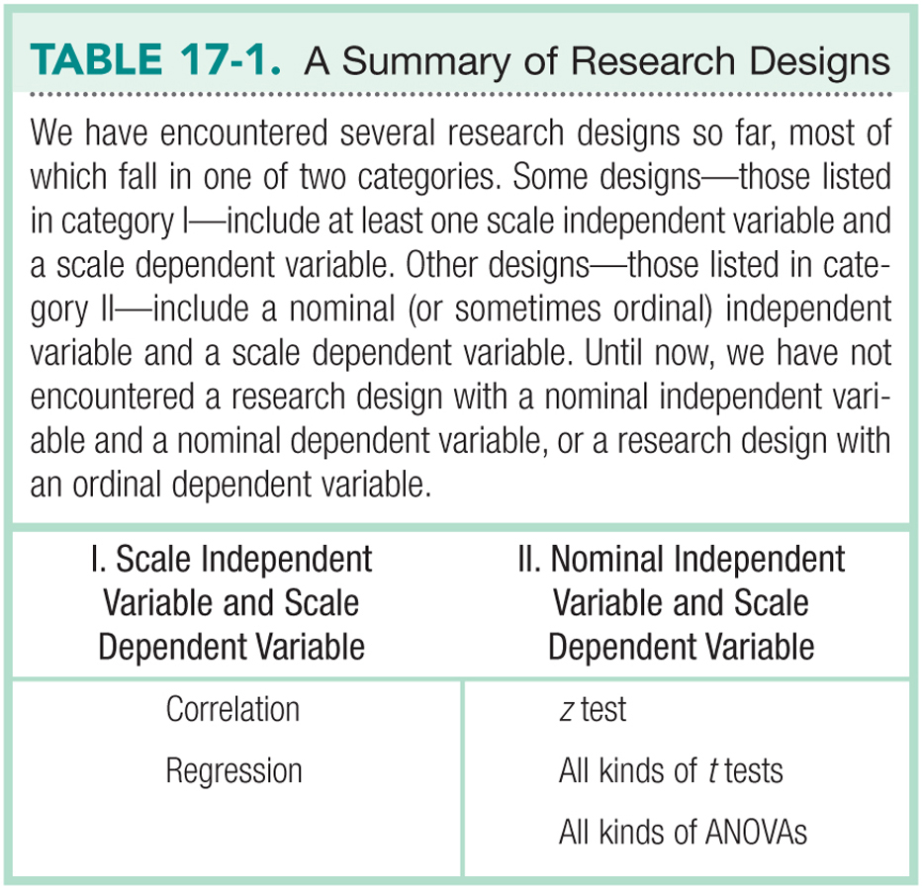

Slide 4
Non-Parametric Statistics
Specifically, for when the DV is NOT a scale variable.
DV is nominal (frequency counts of categories)
DV is ordinal (rankings of categories)
IV is usually also one of these things as well.

Slide 5
Non-Parametric Statistics
Used when the sample size is small
Used when underlying population is not normal

Slide 6
Limitations of Non-Parametric Tests
Cannot easily use confidence intervals or effect sizes
Other things I don’t think are true:
Have less statistical power than parametric tests
Nominal and ordinal data provide less information

Slide 7
Two types of Chi-Square
Goodness of fit test
For when you have ONE nominal variable
Independence test
For when you have TWO nominal variables

Slide 8
Goodness of Fit Test
Step 1: list the variable involved
Statistics classes
This example data examines if the distribution of grades in a statistics course is what we might expect … or better asked: does everyone suck at statistics?

Slide 9
Goodness of Fit Test
Step 2: chi-square is all about expected fit
How much does the the data match what we would expect if these categories were assigned by chance?

Slide 10
Goodness of Fit Test
Step 2:
Observed statistic test categories match the expected variables (O = E)
Observed statistic test categories do not match the expected variables (O/=E)

Slide 11
Goodness of Fit Test
Step 3:
List the observed and expect values
List the df (Categories – 1)

Slide 12
Goodness of Fit Test
Two ways to do expected values:
N (total number of people) / Number of categories
OR
N (total number of people) * expected proportion for that category

Slide 13
Goodness of Fit Test
 | PSY 200 | SOC 302 | MTH 340
A grades | 25 | 18 | 11
observed
 | PSY 200 | SOC 302 | MTH 340
A grades | 18 | 18 | 18
expected

Slide 14
Goodness of Fit Test
df
Number of Categories – 1
3 – 1 = 2

Slide 15
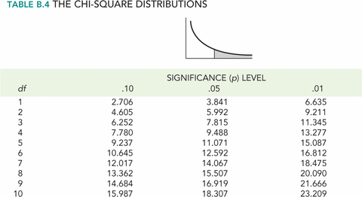
Goodness of Fit Test
Step 4: Cut off score (5.992)
Use a chi-square table

Slide 16
Goodness of Fit Test
Step 5: List chi-square = 5.44

Slide 17
Goodness of Fit Test
Step 6:
Is the found chi-square value > the cut off chi-square value?
This test is like F – everything is squared, so all values are positive.
Nope! Same number of As in each class.

Slide 18
Independence Test
Independence test for two nominal variables
Are the observed values equal to the expect values given the combinations of categories?

Slide 19
Independence Test
Step 1: list the variables involved.
Professors and grade distributions
Now we ask if maybe one professor has a different grading than another professor in our statistics courses.

Slide 20
Independence Test
Step 2: chi-square is all about expected fit
How much does the the data match what we would expect if these categories were assigned by chance?

Slide 21
Independence Test
Step 2:
Observed statistic grades for each professor match the expected variables (O = E)
Observed statistic grades for each professor do not match the expected variables (O/=E)

Slide 22
Independence Test
Step 3: List the observed and expect values
List the df

Slide 23
Independence Test
df = (3-1)(3-1) = 4

Slide 24
Independence Test
Expected values:
E = R*C / N
E = expected
R = row total
C = column total
N = total of everything

Slide 25
Independence Test
Observed | A | B | C | ROW TOTALS
Prof 1 | 5 | 6 | 5 | 16
Prof 2 | 12 | 4 | 3 | 19
Prof 3 | 11 | 9 | 3 | 23
COLUMN TOTALS | 28 | 19 | 11 | N = 58
Expected | A | B | C | ROW TOTALS
Prof 1 | 16*28/58 | 16*19/58 | 16*11/58 | 16
Prof 2 | 19*28/58 | 19*19/58 | 19*11/58 | 19
Prof 3 | 23*28/58 | 23*19/58 | 23*11/58 | 23
COLUMN TOTALS | 28 | 19 | 11 | N = 58

Slide 26
Independence Test
Expected | A | B | C | ROW TOTALS
Prof 1 | 7.72 | 5.24 | 3.03 | 16
Prof 2 | 9.17 | 6.22 | 3.60 | 19
Prof 3 | 11.10 | 7.53 | 4.36 | 23
COLUMN TOTALS | 28 | 19 | 11 | N = 58

Slide 27
Independence Test
Step 4: Cut off score (9.488)
Use a chi-square table

Slide 28
Independence Test
Step 5: List chi-square = 4.82

Slide 29
Independence Test
Step 6:
Is the found chi-square value > the cut off chi-square value?
This test is like F – everything is squared, so all values are positive.
Nope! Same number of ABC grades for each professor.

Slide 30
Cramer’s V (phi)
The effect size for chi-square test for independence
df row/column = smaller number of (R-1) or (C-1)

Slide 31
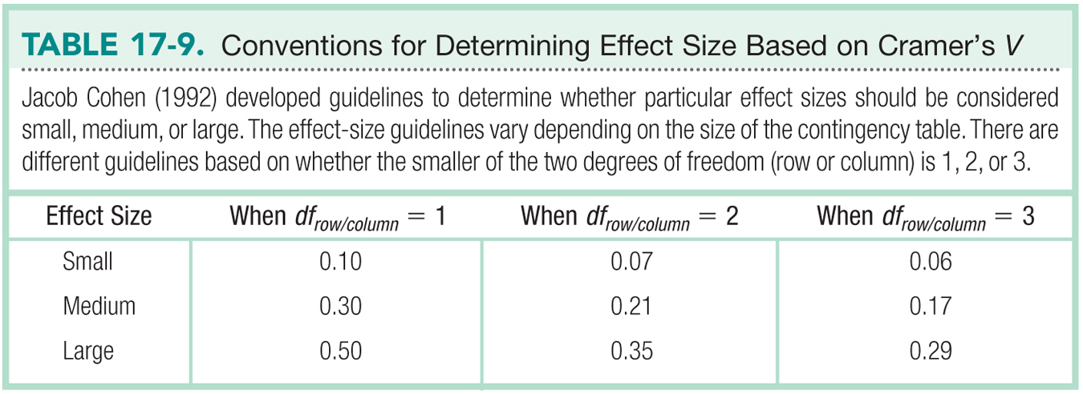

Slide 32
A second set of examples
You can use this section for a second set of examples. In the first section, we covered more of the classic chi-square that would be calculated by “hand” because often you only have summary data.
In this section, we cover the hypothesis testing steps if you had the raw data and wanted to use JASP.

Slide 33
Independence Test
Step 1:
Are there differences in male/female active individuals for the type of sport they choose?
Is there a relationship between gender and sport choice?

Slide 34
Independence Test
Step 1:
Import JASP note: remember each person gets their own row, so we would have each person with their categories listed. Let’s look at the example.
Check out the guide – let’s also make sure they are labeled as categorical variables before moving one.

Slide 35
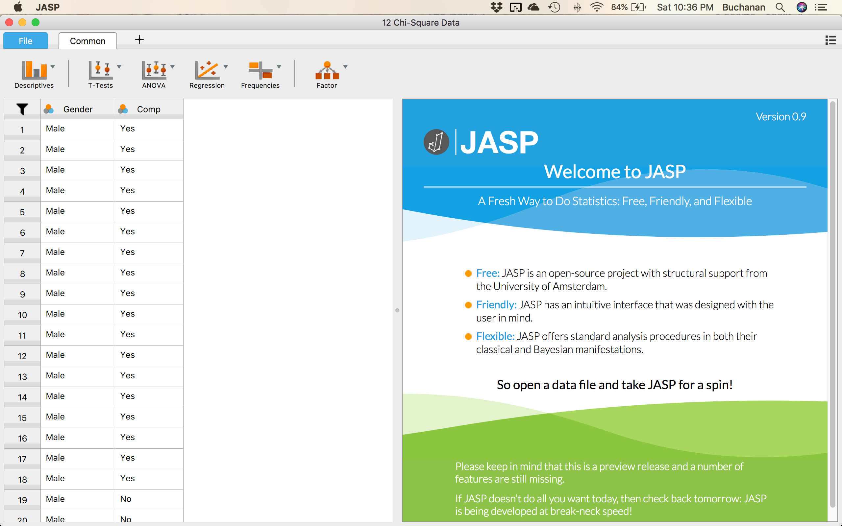
Independence Test

Slide 36
Independence Test
Checking assumptions:
Is the DV categorical? Yes!
Are there at least five people per cell?
Contingency Tables
 |  |  |  | Comp
Gender |  |  |  | Yes | No |  |  | Total
Male |  | Count |  | 18.00 |  | 7.00 |  |  | 25.00
 |  | Expected count |  | 14.00 |  | 11.00 |  |  | 25.00
Female |  | Count |  | 10.00 |  | 15.00 |  |  | 25.00
 |  | Expected count |  | 14.00 |  | 11.00 |  |  | 25.00
Total |  | Count |  | 28.00 |  | 22.00 |  |  | 50.00
 |  | Expected count |  | 28.00 |  | 22.00 |  |  | 50.00

Slide 37
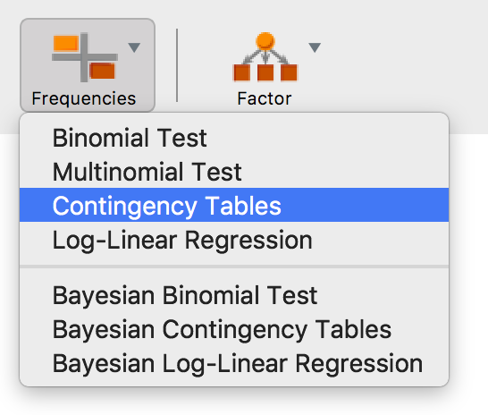
Independence Test
How did we get that?

Slide 38
Independence Test
Step 2:
Observed competitive sport choice is the same for each gender and no relationship between variables (O = E)
Observed competitive sport choice is different for each gender and there is a relationship between variables (O/=E)

Slide 39
Independence Test
Step 3:
List the df
We have two row and two columns, so: (2-1)*(2-1) = 1

Slide 40
Independence Test
Step 4: List the cut off score: 3.841

Slide 41

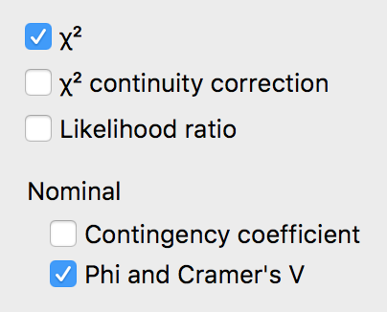
Independence Test
Step 5:
Calculate the chi-square value
Chi-Squared Tests
 |  | Value |  | df |  | p
Χ² |  | 5.195 |  | 1 |  | 0.023
N |  | 50

Slide 42
Independence Test
Step 6:
It appears there is a difference in choice or a relationship between choice and gender.
Contingency Tables
 | Comp
Gender | Yes |  | No |  | Total
Male | 18 |  | 7 |  | 25
Female | 10 |  | 15 |  | 25
Total | 28 |  | 22 |  | 50
Nominal
 | Value
Phi-coefficient | 0.322
Cramer's V | 0.322

